Slide 1

POC
on
Katalon Studio
-Sagar Salunke

Slide 2
Agenda
Katalon Studio Introduction
Katalon Studio Products
Katalon Studio Features
Comparison with Selenium
Pros and Cons
Demonstration

Slide 3
Katalon Studio
Katalon Studio is one of the recognized tools for automated testing.
Katalon studio tool is Robust, Intelligent and scalable automation tool.
Full package of powerfull features.

Slide 4
Katalon Studio Products
Katalon Studio
Katalon RunTime Engine
Katalon TestOps
Katalon Recorder
Katalium
Katalon store

Slide 5
Katalon Studio Features
Testing Environments
Windowa, MacOS, Linux
Applications under Test
Web testing
Mobile testing
API testing
Desktop application testing
Data-driven testing
BDD testing

Slide 6
Katalon Studio Features
Supported Browsers
Google Chrome, Firefox, Microsoft Edge, Safari, Headless.
Scripting Language
Groovy
Object Storage and Maintenance
Page Object Model
Continuous Integration
Jenkins, JIRA.

Slide 7
Katalon Studio VS. Selenium
Feature | Selenium | Katalon Studio
Initial Release | 2004 | 2015
Products | Selenium init, Selenium RC, Selenium Web Driver, Selenium Grid | Katalon Studio, Katalon RunTime Engine, Katalium
Supported Language | Java, Ruby, C#, PhP, Python, Perl | Groovy(Java)
Price | Free | Free Trail(30 days) and Paid Versions
Browser Support | All | All
Integration Options | CI/CD integration with Jenkins and other tools | CI/CD integration with Jenkins and other tools

Slide 8
Katalon Studio PROS
Supports several types of testing:
Keywords-driven.
Data-driven
API-testing
Cross-browser
User-friendly GUI
Inbuilt analytics dashboard and reports
Mild learning curve + learning materials

Slide 9
Katalon Studio CONS
Not open source
Lack of scripting languages
Small community

Slide 10
Katalon Studio Demonstration
Installation
Test Case Creation
Test Case Execution
Logs and Reports
Global Variables
Data Driven Testing
Listeners
Handling Alerts and pop-ups
REST API Testing
BDD Framework

Slide 11
Katalon Analytics
It is web application to view results and collaborate with team.
URL: https://analytics.katalon.com/
To sign up use same credentials of Katalon Studio

Slide 12
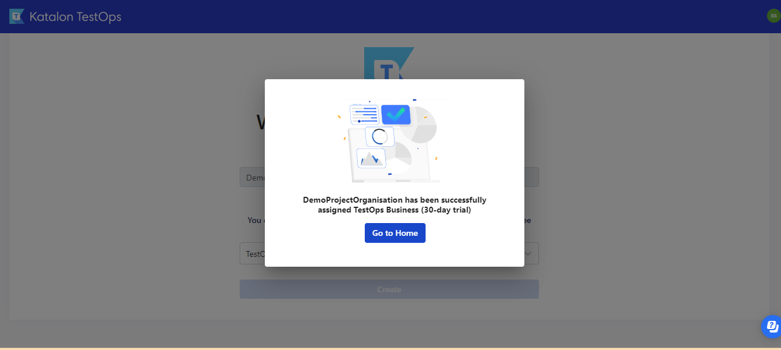
Katalon Analytics

Slide 13
Katalon Analytics Contd.
In Katalon Studio:
Open Project Setting and add the details of project user have created in analytics.katalon.com

Slide 14
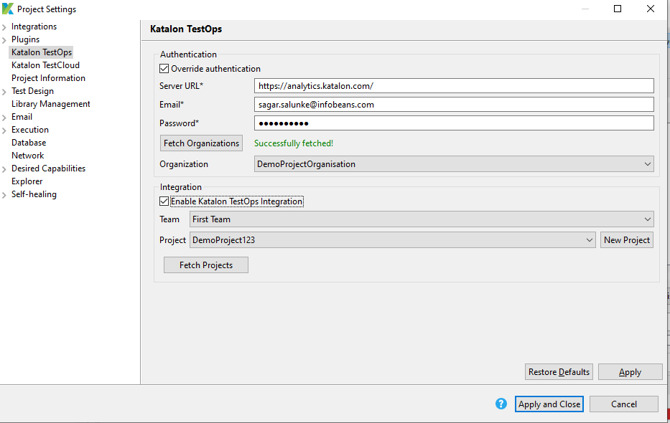
Katalon Analytics

Slide 15
Katalon Analytics Contd.
After executing test suite in Katalon Studio, the reports get generated in analytics.katalon.com in following format

Slide 16
Katalon Analytics Contd.
After executing test suite in Katalon Studio, the reports get generated in analytics.katalon.com in following format

Slide 17
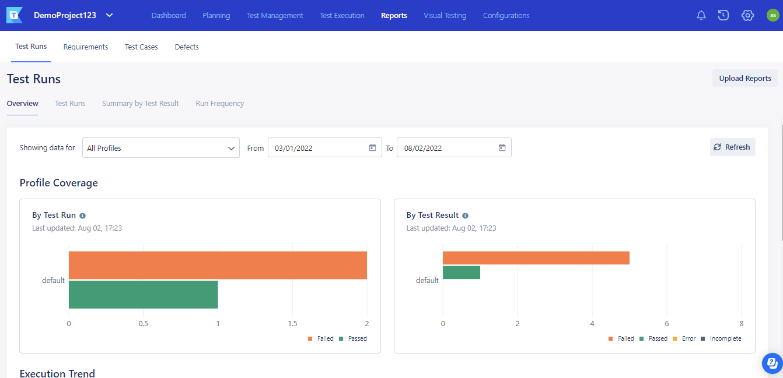
Katalon Analytics

Slide 18
Katalon Profiles
Profiles are nothing but creation of global variables which user can use across the test cases.
User can create different profiles using the

Slide 19
Katalon Keywords
Two Types of Keyword:
BuitIn Keyword
Custom Keyword
User can create custom keyword from Keyword option in test explorer.

Slide 20
Katalon Variables
Three Types of Variables:
Private/Script Variables
Local/Test Variables
Global/Profile Variables

Slide 21
Headless Browser
Katalon supports execution on headless browser.
Select the option of headless browser during the execution of test case.

Slide 22
Reuse Test Case
In Katalon user can refer/reuse test case.
In Katalon Studio click on Add button and select the option “Call Test Case”.

